Slide 1
Time Series Charts Using “dygraphs”
Connor Dobos and Michael Bruno

Slide 2
“dygraphs” Package
Purpose: enable R users to generate dynamic and highly customizable time-series plots with features like zooming, panning, and highlighting, without needing to write JavaScript code.
Key Functionalities:
Interactive time-series plotting
Enhanced user interaction
Integration with R environments
Support for xts objects
Visual Overlays
Handling large datasets
Customization
Notes:
-Enhanced user interaction: zooming, panning, series and point highlighting with mouse hover
-Integration with R environments: embeds with R Markdown and Shiny web applications
-support xts: automatically plots xts time series objects
-visual overlays: shaded regions, event lines, point annotations
-customization: display upper/lower bars, configurable axis and series display

Slide 3
Data + How It Works
Sample data set that provides lung cancer deaths for men and women in the UK from 1974-1979
Best used to show how data changes over time
  In this case, amount of lung deaths for men and women from 1974-1979
Graphs are fully interactive
  Zooming by highlighting section
  Points are marked when mouse goes over them
  Shift + Mouse drag allows for scrolling
  Double click returns to original image
Can be best used to show trends in data as well as predict

Slide 4
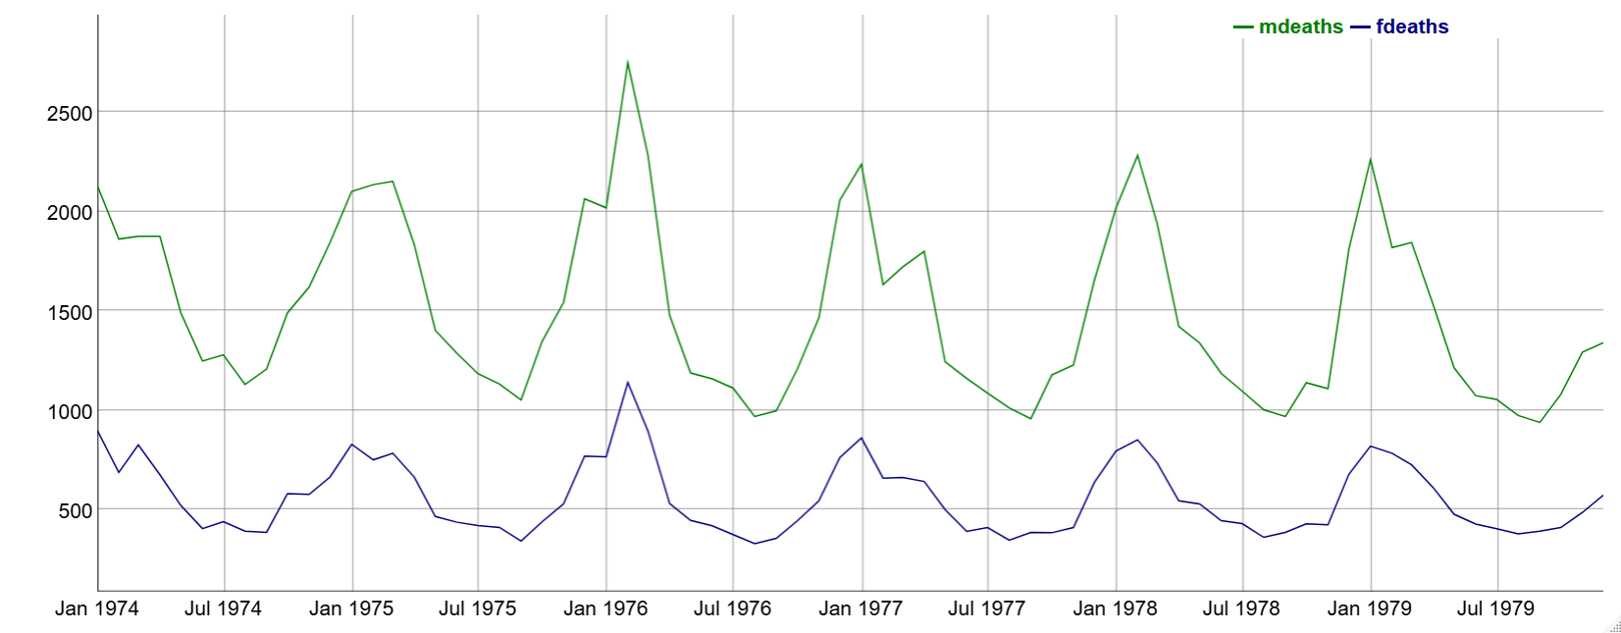
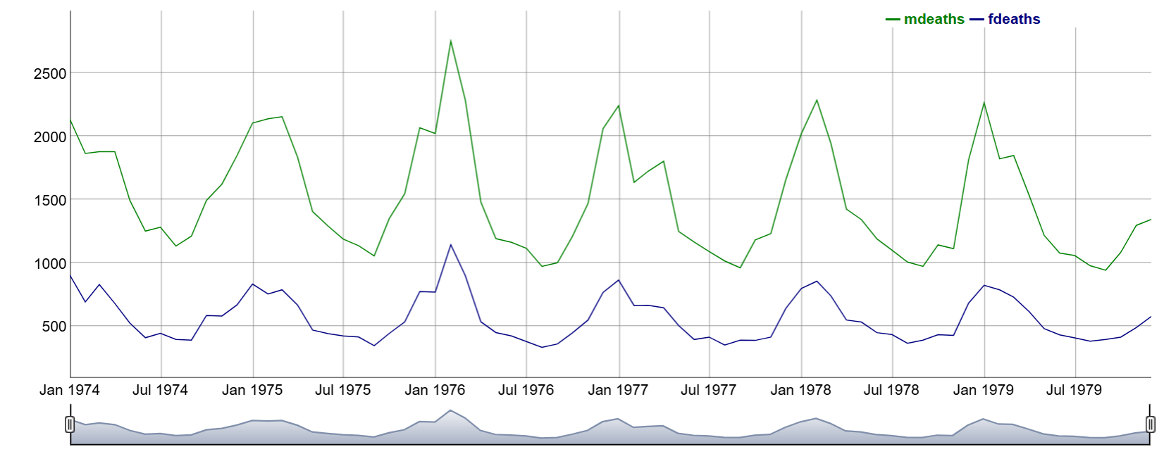
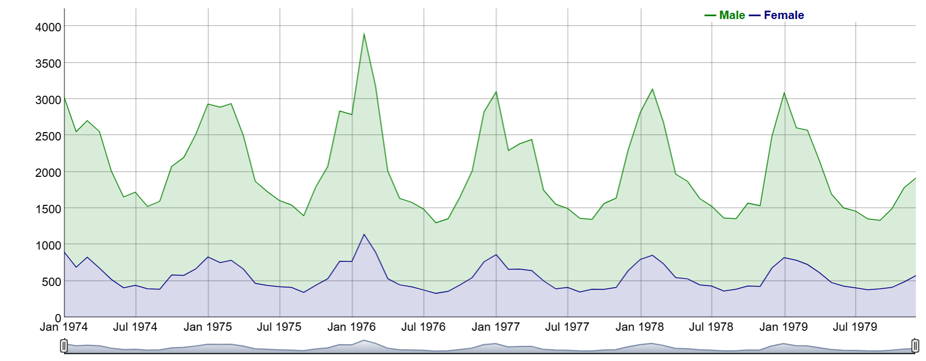
Demo
lungDeaths <- cbind(mdeaths, fdeaths)
dygraph(lungDeaths)
dygraph(lungDeaths) %>% dyRangeSelector()
dygraph(lungDeaths) %>%
  dySeries(“mdeaths”, label = “Male”) %>%
  dySeries(“fdeaths”, label = “Female”) %>%
  dyOptions(stackedGraph = T) %>%
  dyRangeSelector (height = 20)

Slide 5
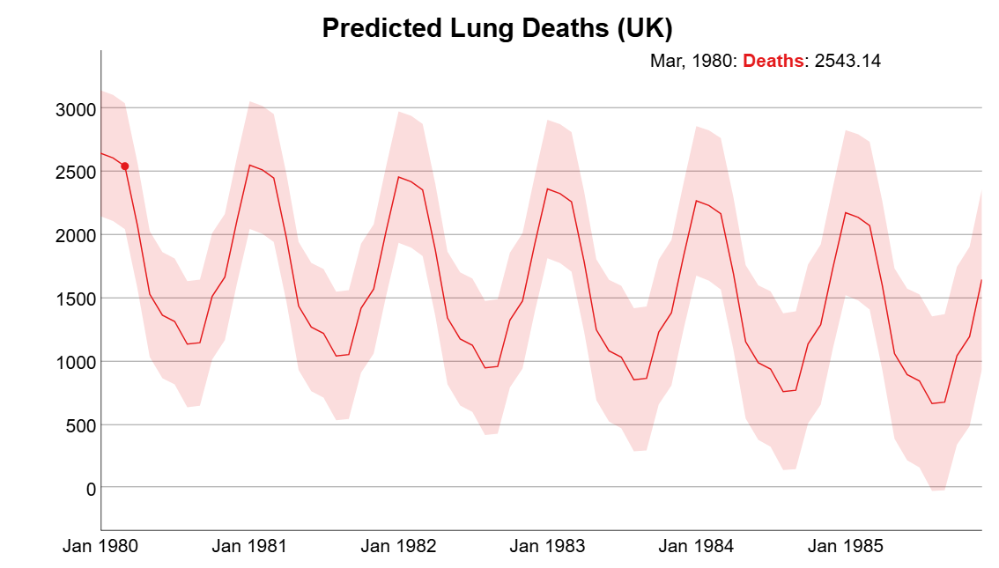
Prediction Chart

